Slide 1
GRADE 1-9 PROGRESS REPORT– INFORMATION FOR PARENTS
Questions?!
Lord Asquith School

Slide 2
GRADE 1-5 PROGRESS REPORT– Information for Parents
What do we want for our children?
Great citizens
Desire to impact their family and their community positively
Resilience
Ability to accept responsibility
Good workers
Strong reading, writing and numeracy skills
Ability to work independently
Successful individuals
Critical thinkers
Ability to be creative
Ability to solve complex problems
Adapted from LOCCSD 2012

Slide 3
GRADE 1-5 PROGRESS REPORT– Information for Parents
What’s changed ?
TRADITIONAL MODEL
SCHOOLS TODAY
Students processed in groups
All processed at the same rate
Teachers as the holders of knowledge and information
Children are prepared for a career path
Repetition of tasks
Individualized instruction and goal setting
Instant access to information
Teachers as facilitators of learning
Children prepared for an uncertain future
More value attached to 21st Century learning skills
Adapted from LOCCSD 2012
Notes:
Parents believe – If the system worked for them – it will work for their kids
The world has changed and education is changing

Slide 4
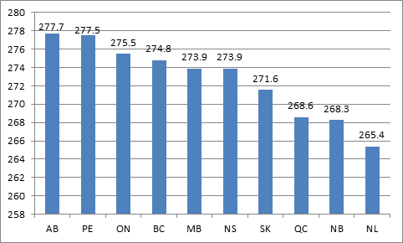
GRADE 1-5 PROGRESS REPORT– Information for Parents
How are we doing?
In comparison to other Provinces?
Literacy Scores by Province 2009
Adapted from LOCCSD 2012
Notes:
You might say we are a good team in a bad league
We have to change the way we work, not just the way we report

Slide 5
GRADE 1-5 PROGRESS REPORT– Information for Parents
How are we doing?
In comparison to other countries?
Adapted from LOCCSD 2012
Notes:
You might say we are a good team in a bad league
We have to change the way we work, not just the way we report

Slide 6
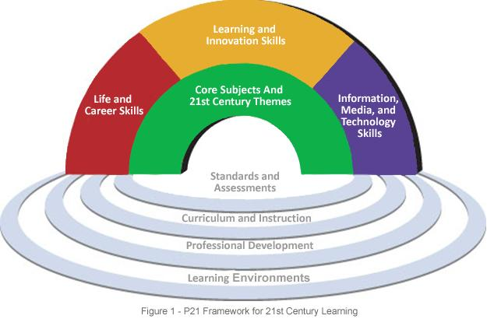
GRADE 1-5 PROGRESS REPORT– Information for Parents
Preparing our children for a very different future
21st Century Learning means:
Problem Solving
Learning how to Learn independently
Critical, creative and innovative thinking
Self assessment and goal setting
Communication
Collaboration
Life and Career Skills
Information, media and technology skills
Adapted from LOCCSD 2012
Notes:
We need to promote higher level learning by design

Slide 7
GRADE 1-5 PROGRESS REPORT– Information for Parents
Changing Curricula
Previous Curricula | Renewed Curricula
Many outcomes (Science 9 – 91 outcomes) | Fewer outcomes (Science 9 – 15 outcomes)
Language of facts and information e.g. Identify parallel branches and series branches within a circuit. | Language of inquiry e.g. Analyze the relationships that exist among voltage, current, and resistance in series and parallel circuits.
Lower levels of thinking Remember, understand | Higher levels of thinking Evaluate, create
Adapted from LOCCSD 2012

Slide 8
Changing practices, changing language
Goal
Outcome
Indicator
What is it?
The big overall idea or theme that multiple outcomes feed into. Typically, this gives students the best opportunity to demonstrate their strengths through multiple opportunities.
The outcomes serve as a “checklist” of all the necessary criteria to be considered “grade-level”.
Achievement of all outcomes is necessary to be considered meeting “grade-level” expectations
Multiple outcomes create a goal area.
The specific pieces of evidence that a student SHOULD be able to demonstrate an understanding of and ability to do.
Multiple indicators create an outcome.
What might it look like?
The areas that are typically reflected on the progress report
What might it look like?
Assignments/projects are based on outcomes.
Outcomes are reported through Powerschool.
Big Ideas posted in class/on bulletin boards/course outlines.
What might it look like?
Work around indicators will typically be daily classroom practice/homework and daily minilessons.
Essential questions are typically based on indicators.

Slide 9
Outcome - CC6.7
Write to describe a place; to narrate an incident from own experience in a multi-paragraph composition and in a friendly letter; to explain and inform in multi-step directions and a short report explaining a problem and providing a solution; and, to persuade to support a viewpoint or stand.
Indicators
Write multi-paragraph (minimum of 3-5 paragraphs) narrative, expository, persuasive, and descriptive texts of at least 400 to 600 words.
Write clear, focused essays that contain a formal introduction, supporting evidence, and a conclusion.
Create narratives about an incident as follows:
establish a plot and setting and present a point of view that is appropriate to the stories
include sensory details
develop plot and character
use a range of narrative devices (e.g., dialogue, suspense, tension).
d) Create expository, informational, and procedural texts, multi-step directions, and a problem/solution presentation as follows:
pose relevant questions and state purpose
explain the situation and develop topic with facts, details, examples, and explanations from multiple sources
follow an organizational pattern
offer evidence to support conclusions.
e) Create descriptive texts about a place as follows:
present a clear picture of the place
include sensory details (five senses) in a logical order (e.g., left to right, far to near).
f) Create persuasive texts on a stand or viewpoint as follows:
state stand or viewpoint
give reasons, facts, and expert opinion to support stand demonstrate sincerity.
g) Experiment with different points of view (i.e., first person as well as third person).
h) Share writing-in-progress in various ways (e.g., author’s circle, peer response).

Slide 10
GRADE 1-5 PROGRESS REPORT– Information for Parents
Renewed Curricula
http://www.progetudes.gov.sk.ca/
Adapted from LOCCSD 2012

Slide 11
GRADE 1-5 PROGRESS REPORT– Information for Parents
So why are we changing?
To reflect new curriculum
To reflect the best research
Black and Wiliam – Inside the Black Box, 1998
Ken O’Connor – A Repair Kit for Grading, 2010
Anne Davies – Leading the Way, 2011
Damian Cooper – Talk about Assessment, 2006
To communicate more clearly with parents
To support 21st Century Learning
Moving towards outcomes-based and curriculum-referenced assessment
Inclusive – A progress report for all learners
Promoting higher levels of learning
Consistent reporting throughout Prairie Spirit
Part of an Assessment System including:
Student-involved conferences
Interim reports
Connecting with parents
Division and Provincial assessments
Portfolios
Adapted from LOCCSD 2012
Notes:
One of the last school Divisions to move to common report card

Slide 12
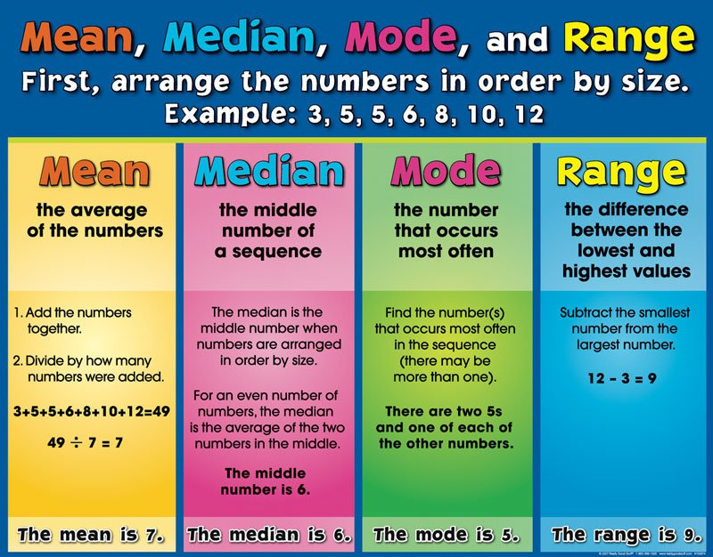
But I like percents…

Slide 13
So how do I know how my kid is doing with this new scale?!
Jet Bikes
Have you ever run a business from a playhouse? My friends and I have. It is a bike shop. We call it Jet Bikes.
One day my friend Trent asked me and my brother Jared if we wanted to build a bike shop out of his old playhouse. Jared and I said, “Yes.” So we went to get permission from my mom to go to Trent’s house and get started.
The first thing we did was get some things out of his garage. We got old, rusty bolts; new, shiny nuts; black tape; wrenches; half-empty cans of oil; and screws. Then we built a new roof for the playhouse. We also had to clean the dirt and leaves out of it.
So far we’ve only worked on our own bikes because not many people know about our shop. We had to fix Trent’s chain a few times. We also had to fix his tire because it would go flat every five minutes. We changed the inner tube and also used some stuff called “No More Flats.” Now it never goes flat!
When we are older, we plan on putting signs up around town and maybe even an ad in the newspaper. We will work on bikes as big as 20 speeds and as small as bikes with training wheels. We hope to have a lot of customers.
Do you think you’ll ever come here with a bike for my friends and me to work on? I hope so because it would be fun to have some customers, and it might be fun for you to have kids fix your bike!
What % would you give this?
What’s easy about marking this?
What’s difficult about marking this?
Notes:
Increased gradients decrease reliability.

Slide 14
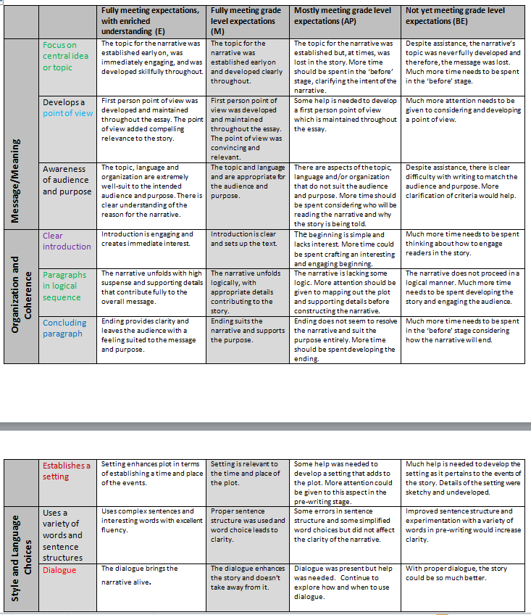
So how do I know how my kid is doing with this new coding system?
CC6.7Write to narrate an incident from own experience in a multi-paragraph composition
Write multi-paragraph (minimum of 3-5 paragraphs) narrative, expository, persuasive, and descriptive texts of at least 400 to 600 words.
Write clear, focused essays that contain a formal introduction, supporting evidence, and a conclusion.
Create narratives about an incident as follows:
- establish a plot and setting and present a point of view that is appropriate to the stories
- include sensory details
- develop plot and character
- use a range of narrative devices (e.g., dialogue, suspense, tension).
Experiment with different points of view (i.e., first person as well as third person).
Share writing-in-progress in various ways (e.g., author’s circle, peer response).
Notes:
The key to outcome based assessment is strong criteria, typically represented in rubrics.

Slide 15
GRADE 1-5 PROGRESS REPORT– Information for Parents
The Progress Report
Notes:
Look at the report card in your hand. We will split off into groups and you can ask teachers any questions.

Slide 16
GRADE 1-5 PROGRESS REPORT– Information for Parents
The Development Process
Pilot Schools
The Assessment Residency
Parent, teacher and student feedback
Focus groups and surveys
Using technology
Adapted from LOCCSD 2012
Notes:
One of the last school Divisions to move to common report card

