Slide 1
FATS

Slide 2
What are Fats
Fats fit under an umbrella term call lipids. Lipids are organic substances that are insoluble in water. This means that they do not dissolve in water only disperse
three types of fats that are found in our food are
Triglyceride- which make up most of the fat we eat (95%)
Phospholipids- these are needed for cell membranes
Sterols- which the body can produce on its own
Notes:
this is where bring the water and oil in a test tube will fit in, have one or two of the students shake it as hard and long as they want then have it settle on the table and separate out, we need to get lighter fluid.

Slide 3
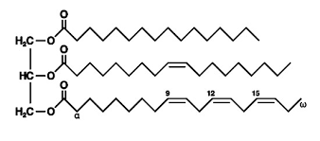
Triglycerides
most common fat that people receive in their diet. It is also the most common way body fat is stored.
triglycerides -three fatty acids with a glycerol backbone.
there are three types of triglycerides
Saturated fats
Unsaturated fats
Trans Fatty acids

Slide 4
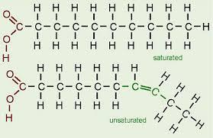
Saturated Fats
saturated fats are fatty acids that within the chain all carbons atoms are Saturated *bonded* with hydrogen atoms
This creates long straight chains which are able to stack on top of each other.
Because of this Saturated fats are solids at room temperatures

Slide 5
Unsaturated Fats
Unsaturated fats differ from saturated fats because they contain carbons double bonded to other carbons. These double bond causes the fatty acids to bend so that they are not straight. This makes unsaturated fats liquids at room temperatures.
Unsaturated fats that contain one double bond are call Monounsaturated. if the unsaturated fat contains two or more double bonds it is called a Polyunsaturated.
The more double bonds in the carbon chain the more bends and kinks in the fat molecule and the less compressed the fats are together.

Slide 6
Trans Fats
Trans fats are saturated fats that have been modified to be like unsaturated fats. Hydrogen atoms have been added to break the double bonds and straighten out the chain. This process is called hydrogenation.

Slide 7
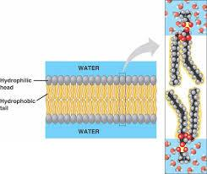
Phospholipids
Phospholipids are made up of two fatty acids with a glycerol backbone that contains a phosphate..
This is important within the body because it aids in the transport of fats in the blood stream. The backbone that has the phosphate atom likes to interact with water (hydrophilic), while the fatty acid chain or tail doesn’t like to interact with water (hydrophobic).
This creates a sphere in which fat soluble molecules to be transported in the body.

Slide 8
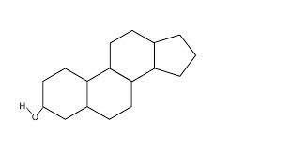
Sterols
sterols are lipids that have a ring structure
the most common sterol is cholesterol.
cholesterol is important in the body because it is a key part of cell membrane that maintains membrane structural integrity and fluidity.
cholesterol is oxidized in the liver to form a variety of bile acids that aid digestion.
Cholesterol is also the backbone to the creation of the sex and adrenal hormones

Slide 9
Why do we need fats?
fats play many roles in healthy body. Fats are important in the following functions
provide energy
for activities and for when we are at rest
allow the body to transport fat-soluble vitamins
help maintain cell function
being a part of all the cell membranes
protects major organs in our body
helps people feel full
fats are digested at a much slower rate than carbohydrates and proteins due to having a higher energy level and that there are more steps in the digestion process

