Slide 1
Reproductive System
Gross Anatomy

Slide 2
Reproductive system appears to “slumber” until puberty
Gonads (primary sex organs)
Testes in men
Ovaries in woman

Slide 4
Male Reproductive System

Slide 5
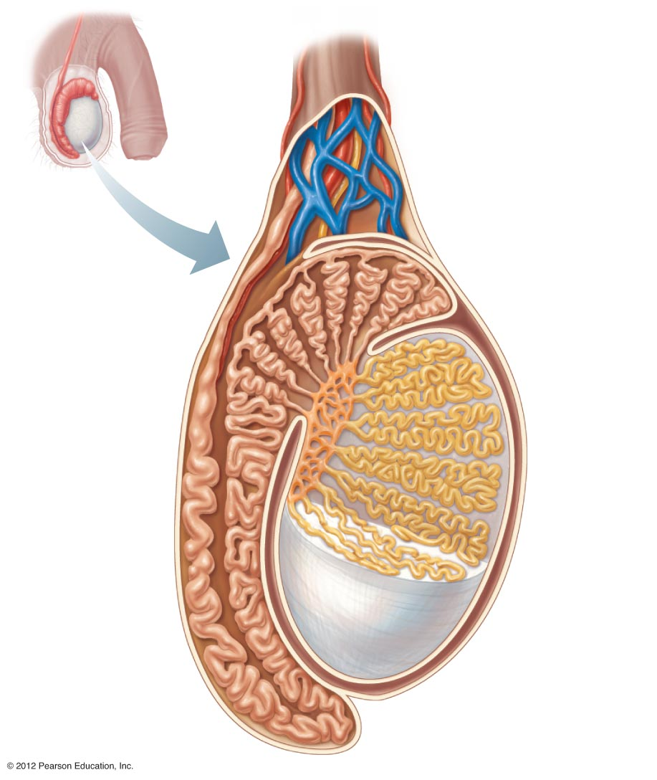
Spermatic cord
Blood vessels
and nerves
Seminiferous
tubule
Ductus (vas)
deferens
Lobule
Septum
Tunica
albuginea
Epididymis

Slide 6
Testes – Primary reproductive organ
Seminiferous tubules – “sperm forming factories
Testosterone is produced by interstitial cells that surround the seminiferous tubules
Sperm producing and hormone producing functions of the testes are carried out in completely different cells

Slide 7
Viable sperm can not be produced at normal body temperature
Requires approx. 3 degrees lower
If the temp is too cold scrotum pulls the testes closer to the body

Slide 8
A series of ducts (Epididymis) move the immature sperm
A storage site for sperm
A trip that takes approx. 20 days
As they move along they gain the ability to swim
During ejaculation sperm is pushed from the storage site to the Vas deferens

Slide 9
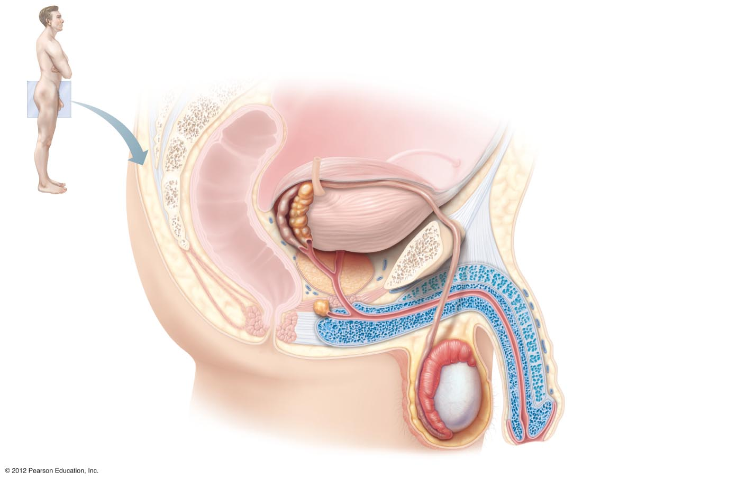
Ureter
Urinary bladder
Seminal vesicle
Prostatic urethra
Pubis
Membranous urethra
Ejaculatory duct
Urogenital diaphragm
Rectum
Prostate
Erectile tissue
of the penis
Bulbourethral gland
Spongy urethra
Ductus (vas) deferens
Shaft of the penis
Epididymis
Glans penis
(a)
Testis
Prepuce
Scrotum
External urethral
orifice

Slide 10
Accessory Glands and Semen
Urethra carries both urine and sperm but not at the same time
Seminal Vesicles – produce about 60%of seminal fluid (feed and activate the sperm)
Prostate – secretes a milky fluid that plays a role in activting sperm
Semen- mixture of sperm and accessory gland secretions
Liquid portion acts as a transport medium for nutrients and chemicals that protect sperm
During ejaculation 2-5mL of semen is produced containing 50 to 150 million sperm in each mL

Slide 12
External Genitalia
The penis is designed to deliver sperm into the female reproductive tract
It consists of a shaft made up of erectile tissue, a glans penis and a prepuce (foreskin)

Slide 13
Female Reproductive system

Slide 14
The reproductive role of a female is much more complex than a male
Ovaries are the primary reproductive organ
Like the testes they produce both the gamete (egg) and the hormones (estrogen and progesterone)
Other organs serve to transport, nurture or serve the needs of reproductive cells/ developing fetus

Slide 15
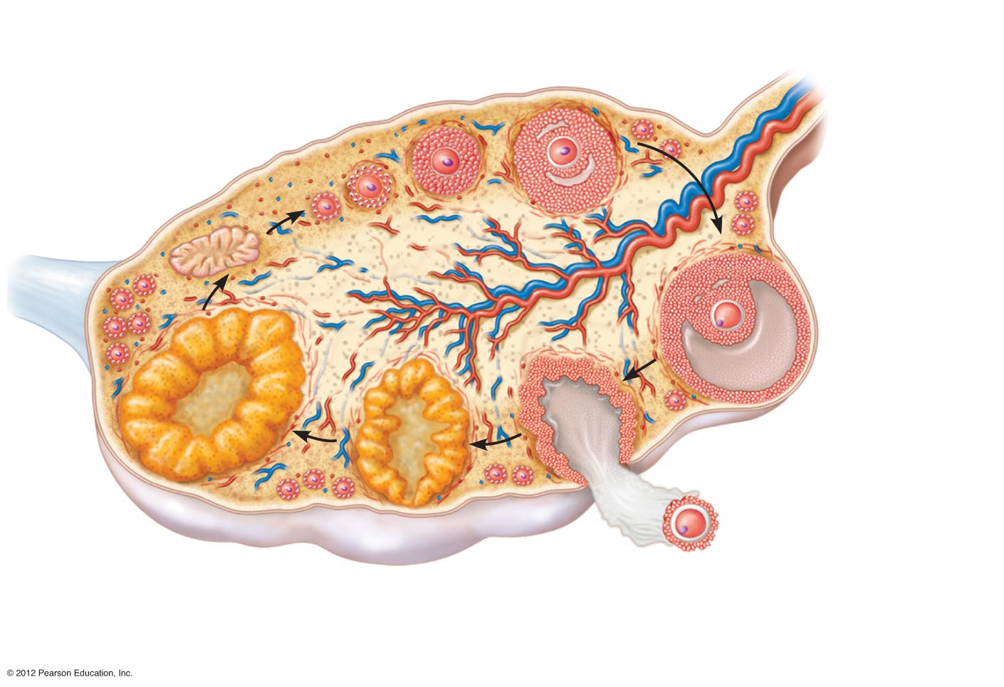
Growing follicles
Primary follicle
Degenerating
corpus luteum
Blood
vessels
Mature vesicular
(Graafian) follicle
Germinal
epithelium
Corpus luteum
Developing
corpus luteum
Ruptured
follicle
Ovulation
Secondary oocyte

Slide 16
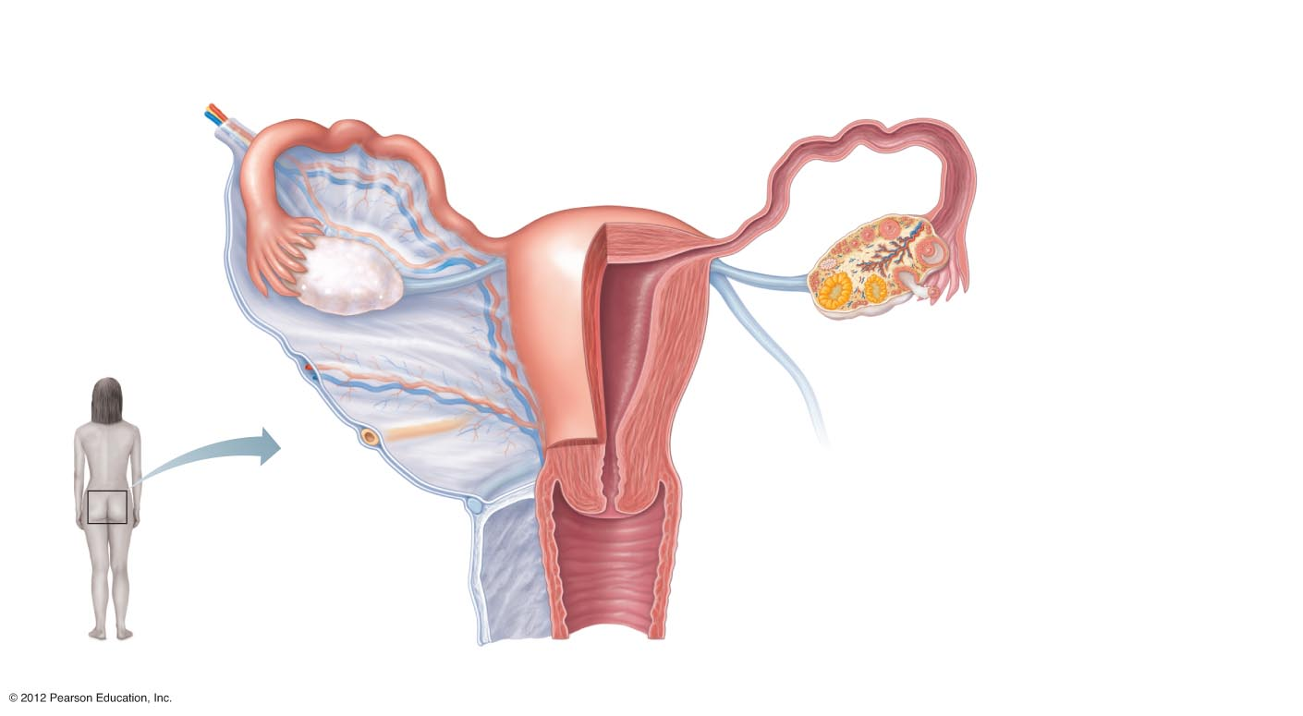
Suspensory
ligament of ovary
Uterine (fallopian) tube
Ovarian
blood
vessels
Fundus
of uterus
Lumen (cavity)
of uterus
Ovary
Broad
ligament
Infundibulum
Uterine
tube
Fimbriae
Ovarian ligament
Round ligament of uterus
Body of
uterus
Endometrium
Myometrium
Wall of
uterus
Perimetrium
Ureter
Uterine blood
vessels
Cervical canal
Uterosacral
ligament
Cervix
Vagina
(b)

Slide 17
Duct System
Fallopian Tubes (uterine tubes)– receive the ovulated oocyte and provide a site where fertilization can occur
Unlike the male duct system no contact between uterine tubes and ovaries,
distal end of each tube expands in a funnel shaped (infundibulum) that has finger like projections (fimbriae)
These waving fimbriae create currents that carry the oocyte into the tube (not always successful)

Slide 18
Uterus
Functions to receive, retain and nourish a fertilized egg
Major portion of the uterus is referred to as the body
Superior rounded region above entrance to uterine tubes is the fundus
Narrow opening to vagina is the cervix
The wall of the uterus is thick and composed of 3 layers
Endometrium – where implantation occurs, if not implantation doesn’t occur layer is sloughed off (menstruation) in response to changes in hormone levels in the body
Myometrium – composed of smooth muscle that plays an active role in delivery of a baby – where contractions are produced

Slide 19
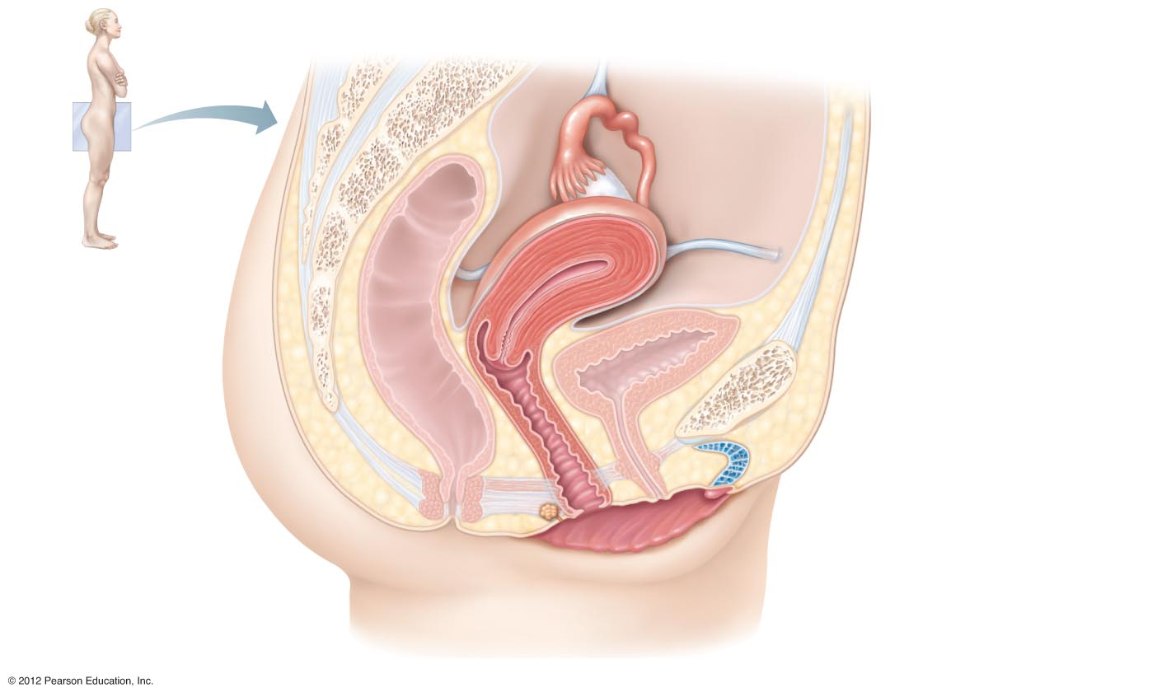
Suspensory ligament
of ovary (part of broad
ligament)
Infundibulum
Uterine tube
Ovary
Fimbriae
Uterus (fundus)
Uterosacral
ligament
Round ligament
Urinary bladder
Rectum
Pubic symphysis
Mons pubis
Cervix
Urethra
Vagina
Clitoris
Anus
Hymen
Greater vestibular gland
Labium minus
Labium majus
(a)

Slide 20
Vagina and External Genitalia
Vagina - Thin walled tube 8-10cm long
Vulva – external genitalia
Mons pubis
Labia
Clitoris
Urethral and vaginal orifices
Greater vestibular glands

